Slide 1
Active Worms, Buffer Overflow Attacks and BGP Attacks
CSE 4471: Information Security

Slide 2
Active Worms

Slide 3
Active Worm vs. Virus
Active Worm
  A program that propagates itself over a network, reproducing itself as it goes
Virus
  A program that searches out other programs and infects them by embedding a copy of itself in them

Slide 4
Active Worm vs. DDoS
Propagation
  Active worm: from few to many
  DDoS: from many to few
Relationship
  Active worm can be used for network reconnaissance, preparation for DDoS

Slide 5
Instances of Active Worms (1)
Morris Worm (1988) [1]
  First active worm; took down several thousand UNIX
  machines on Internet
Code Red v2 (2001) [2]
  Targeted, spread via MS Windows IIS servers
  Launched DDoS attacks on White House, other IP addresses
Nimda (2001, netbios, UDP) [3]
  Targeted IIS servers; slowed down Internet traffic
SQL Slammer (2003, UDP) [4]
  Targeted MS SQL Server, Desktop Engine
  Substantially slowed down Internet traffic
MyDoom (2004–2009, TCP) [5]
  Fastest spreading email worm (by some estimates)
  Launched DDoS attacks on SCO Group

Slide 6
Instances of Active Worms (2)
Jan. 2007: Storm [6]
  Email attachment downloaded malware
  Infected machine joined a botnet
Nov. 2008–Apr. 2009: Conficker [7]
  Spread via vulnerability in MS Windows servers
  Also had botnet component
Jun.–Jul. 2009, Mar.–May 2010: Stuxnet [8–9]
  Aim: destroy centrifuges at Natanz, Iran nuclear facility
  “Escaped” into the wild in 2010
Aug. 2011: Morto [10]
  Spread via Remote Desktop Protocol
  OSU Security shut down RDP to all OSU computers

Slide 7

How an Active Worm Spreads
Autonomous: human interaction unnecessary
(1) Scan
(2) Probe
(3) Transfer copy
infected
machine
machine
Infected

Slide 8
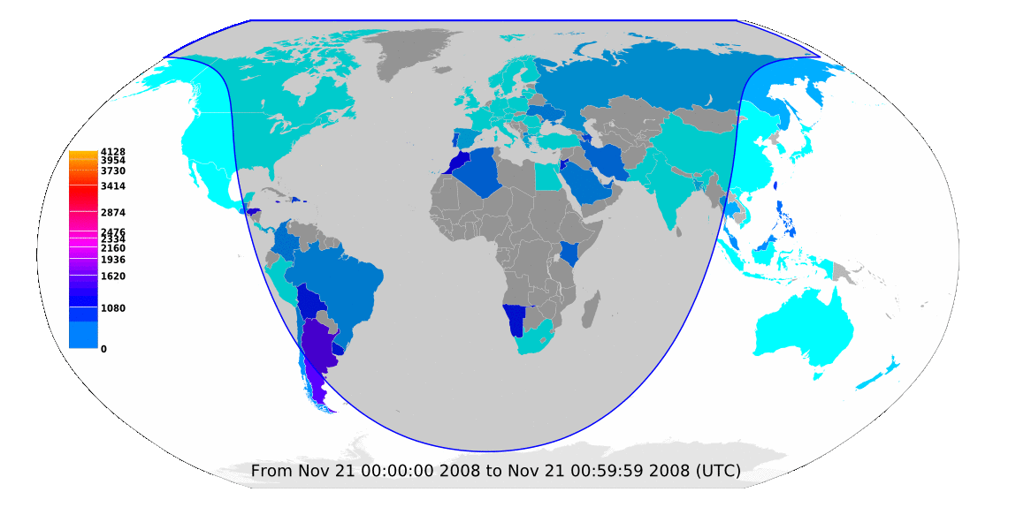
Conficker Worm Spread
Data normalized for each country.
Source: [7]

Slide 9
Scanning Strategies
Random scanning
  Probes random addresses in the IP address space (CRv2)
Hitlist scanning
  Probes addresses from an externally supplied list
Topological scanning
  Uses information on compromised host (Email worms, Stuxnet)
Local subnet scanning
  Preferentially scans targets that reside on the same subnet. (Code Red II & Nimda)

Slide 10
Techniques for Exploiting Vulnerabilities
Morris Worm
  fingerd (buffer overflow)
  sendmail (bug in “debug mode”)
  rsh/rexec (guess weak passwords)
Code Red, Nimda, etc. (buffer overflows)
Tricking users into opening malicious email attachments

Slide 11
Worm Exploit Techniques
Case study: Conficker worm
  Issues malformed RPC (TCP, port 445) to Server service on MS Windows systems
  Exploits buffer overflow in unpatched systems
  Worm installs backdoor, bot software invisibly
  Downloads executable file from server, updates itself
Workflow: see backup slides (1), (2)

Slide 12

Worm Behavior Modeling (1)
Propagation model mirrors epidemic:
V : total # of vulnerable nodes
N : size of address space
i(t): percentage of infected nodes among V
r : an infected node’s scanning speed
Notes:
\frac{\mathrm{d}i(t)}{\mathrm{d}t} = \frac{rV}{N} \cdot i(t) \cdot (1 - i(t))
\noindent\text{Solution} i(t) = \frac{\exp\left\{\frac{rV}{N} \cdot t + C\right\}}{\exp\left\{\frac{rV}{N} \cdot t + C\right\} - 1}, \smallskip\\\text{\qquad where } \exp\{t\} \equiv e^t, C \text{ is constant}

Slide 13
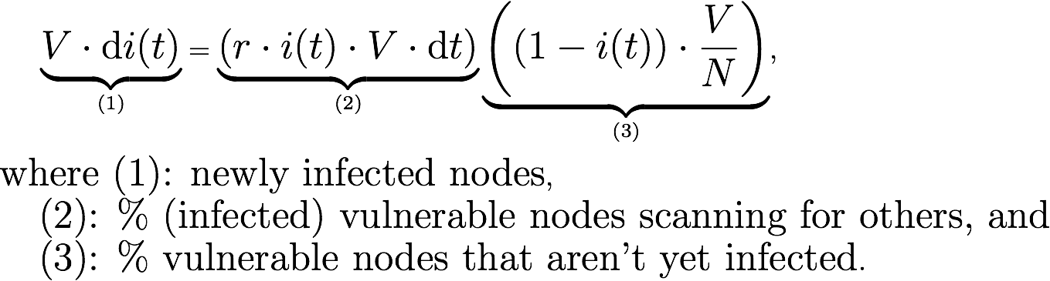
Worm Behavior Modeling (2)
Multiply (*) by V ⋅ dt and collect terms:
The total number of newly infected nodes
The total number of scannings launched by infected nodes
The percentage of vulnerable non-infected nodes in space address
Notes:
\Large{\underbrace{V \cdot \mathrm{d}i(t)}_\text{(1)} = \underbrace{(r \cdot i(t) \cdot V \cdot \mathrm{d}t)}_\text{(2)} \underbrace{\left( (1 - i(t)) \cdot \frac{V}{N} \right)}_\text{(3)}}\smallskip,\\
\text{where (1): infection rate among vulnerable nodes},\\\text{\quad(2): \% (infected) vulnerable nodes scanning for others, and}\\\text{\quad(3): \% vulnerable nodes that aren't yet infected}.

Slide 14
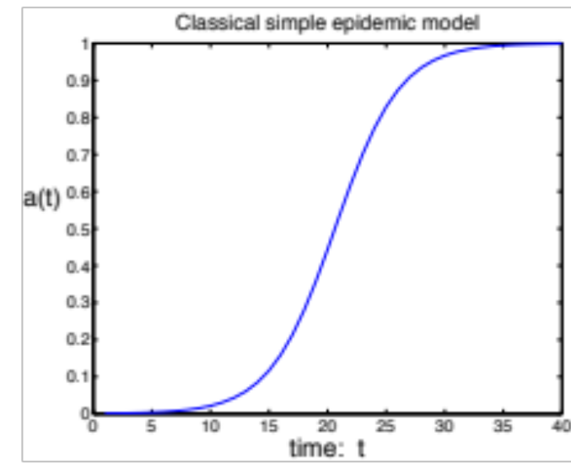
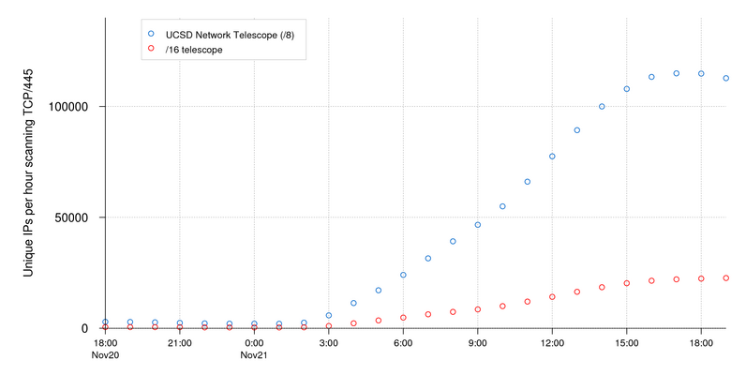
Modeling the Conficker Worm
This model’s predicted worm propagation similar to Conficker’s actual propagation
Conficker’s propagation
Sources: [7], Fig. 2; [8], Fig. 4

Slide 15
Practical Considerations
This model assumes machine state: vulnerable → infected
  In reality, countermeasures slow worm infection
    Infected machines can be “cleaned” (removed from epidemic)
    State: vulnerable → infected → removed
  Attackers may limit, vary worm scan rate
  Complicates mathematical models
    Need time-varying parameters for number of removed hosts R(t), worm scan rate r(t)
    Resulting differential equations are complex, cannot be solved using calculus alone

Slide 16
Summary
Worms can spread quickly:
  359,000 hosts in under 14 hours
Home / small business hosts play significant role in global internet health
  No system administrator ⇒ slow response
  Can’t estimate infected machines by # of unique IP addresses: DHCP effect apparently real, significant
Active Worm Modeling

Slide 17
References (1)
Wikipedia, “Morris worm,” https://en.wikipedia.org/wiki/Morris_worm
Wikipedia, “Code Red (computer worm),” https://en.wikipedia.org/wiki/
Code_Red_worm
Wikipedia, “Nimda,” https://en.wikipedia.org/wiki/Nimda
Wikipedia, “SQL Slammer”, https://en.wikipedia.org/wiki/SQL_Slammer
Wikipedia, “MyDoom”, https://en.wikipedia.org/wiki/Mydoom
Wikipedia, “Storm worm,” https://en.wikipedia.org/wiki/Storm_Worm
Wikipedia, “Conficker,” https://en.wikipedia.org/wiki/Conficker
D. E. Sanger, “Obama Order Sped Up Wave of Cyberattacks Against Iran,” The New York Times, 1 Jun. 2012, https://www.nytimes.com/2012/06/01/world/
middleeast/obama-ordered-wave-of-cyberattacks-against-iran.html
N. Falliere, L. O. Murchu, and E. Chien, Symantec, “W32.Stuxnet,” Feb. 2011, http://www.symantec.com/security_response/writeup.jsp?docid=2010-071400-3123-99
T. Bitton, “Morto Post Mortem: Dissecting a Worm,” 7 Sep. 2011, http://blog.imperva.com/2011/09/morto-post-mortem-a-worm-deep-dive.html
Cooperative Association for Internet Data Analysis (UCSD), “The Spread of the Code-Red Worm (CRv2),” 2001, http://www.caida.org/research/security/code-red/
coderedv2_analysis.xml

Slide 18
References (2)
Cooperative Association for Internet Data Analysis (UCSD), “Conficker/Conflicker/Downadup as seen from the UCSD Network Telescope”, 2009, http://www.caida.org/research/security/ms08-067/conficker.xml
C. C. Zou, W. Gong, and D. Towsley, “Code Red Worm Propagation Modeling and Analysis,” Proc. ACM CCS, 2002.
P. Porras, H. Saidi, and V. Yegneswaran, 19 Mar. 2009, http://mtc.sri.com/Conficker/

Slide 19
Backup Slides

Slide 20
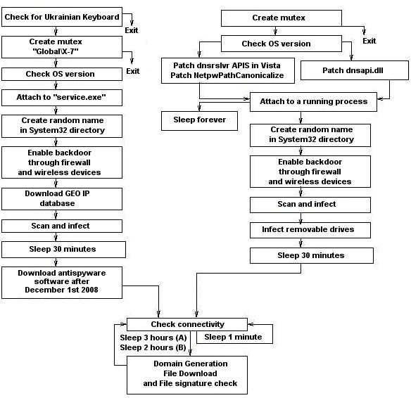
Conficker Workflow (1)
Conficker’s exploitation workflow.
Source: [14], Fig. 1

Slide 21
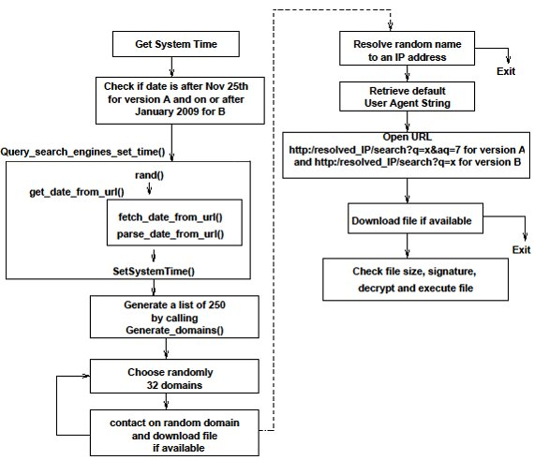
Conficker Workflow (2)
Conficker’s self-update workflow.
Source: [14], Fig. 3

Slide 22
Buffer Overflow Attacks

Slide 23
Acknowledgement
The contents of this lecture come from the following links:
  https://courses.cs.washington.edu/courses/cse451/05sp/section/overflow1.ppt
  http://www.cs.ucf.edu/~czou/CAP6135-12/bufferOverFlow-1.ppt
  http://web2.clarkson.edu/class/cs457/security.sp06/labs/bufferOverflow/BufferOverflow.ppt

Slide 24
What is a Buffer Overflow?
Intent
  Arbitrary code execution
    Spawn a remote shell or infect with worm/virus
  Denial of service
    Cause software to crash
      E.g., ping of death attack
Steps
  Inject attack code into buffer
  Overflow return address
  Redirect control flow to attack code
  Execute attack code

Slide 25
Attack Possibilities
Targets
  Stack, heap, static area
  Parameter modification (non-pointer data)
    Change parameters for existing call to exec()
    Change privilege control variable
Injected code vs. existing code
Absolute vs. relative address dependence

Slide 26
The Problem
void foo(char *s) {
char buf[10];
strcpy(buf,s);
printf(“buf is %s\n”,s);
}
…
foo(“thisstringistoolongforfoo”);

Slide 27
Exploitation
The general idea is to give servers very large strings that will overflow a buffer.
For a server with sloppy code – it’s easy to crash the server by overflowing a buffer (SEGV typically).
It’s sometimes possible to actually make the server do whatever you want (instead of crashing).

Slide 28
Background Necessary
C functions and the stack.
A little knowledge of assembly/machine language.
How system calls are made (at the machine code level).
exec() system calls
How to “guess” some key parameters.

Slide 29
C Function and the Stack
When a function call is made, the return address is put on the stack.
Often the values of parameters are put on the stack.
Usually the function saves the stack frame pointer (on the stack).
Local variables are on the stack.

Slide 30
Address Space
0xFFFFFFFF
kernel space
0xC0000000
stack
shared library
0x42000000
heap
bss
static data
code
0x08048000
0x00000000
From Dawn Song’s RISE: http://research.microsoft.com/projects/SWSecInstitute/slides/Song.ppt

Slide 31
Stack Basics
A stack is contiguous block of memory containing data.
Stack pointer (SP) – a register that points to the top of the stack.
The bottom of the stack is at fixed address.
Its size is dynamically adjusted by kernel at run time.
CPU implements instructions to PUSH onto and POP off the stack.

Slide 32
A Stack Frame
high
Parameters
Return Address
Calling Stack Pointer
Local Variables
SP+offset
SP
Addresses
00000000
low

Slide 33
Sample
Stack
18
addressof(y=3) return address
saved stack pointer
y
x
buf
x=2;
foo(18);
y=3;
void foo(int j) {
int x,y;
char buf[100];
x=j;
…
}

Slide 34
Another Example Code
void function(int a, int b, int c) {
char buffer1[5];
char buffer2[10];
}
void main(){
function(1,2,3);
}

Slide 35
Stack Layout for the Example Code
bottom of top of
memory memory
buffer2 buffer1 sfp ret a b c
<------ [ ][ ][ ][ ][ ][ ][ ]
Top of stack bottom of stack

Slide 36
Smashing the Stack
The general idea is to overflow a buffer so that it overwrites the return address.
When the function is done it will jump to whatever address is on the stack.
We put some code in the buffer and set the return address to point to it!

Slide 37
Before and After
void foo(char *s) {
char buf[100];
strcpy(buf,s);
…
address of s
address of s
return-address
pointer to pgm
Small Program
saved sp
buf

Slide 38
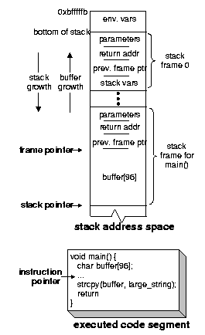
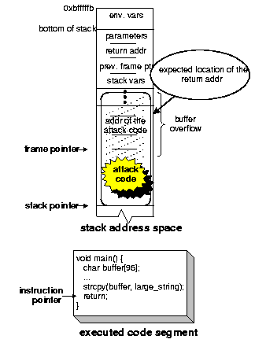
(i) Before the attack
(ii) after injecting the attack code

Slide 39
Issues
How do we know what value the pointer should have (the new “return address”).
  It’s the address of the buffer, but how do we know what address this is?
How do we build the “small program” and put it in a string?

Slide 40
Guessing Addresses
Typically you need the source code so you can estimate the address of both the buffer and the return-address.
An estimate is often good enough! (more on this in a bit).

Slide 41
Building the
Small Program
Typically, the small program stuffed in to the buffer does an exec().
Sometimes it changes the password db or other files…

Slide 42
exec() Example
#include <stdio.h>
char *args[] = {"/bin/ls", NULL};
void execls(void) {
execv("/bin/ls",args);
printf(“I’m not printed\n");
}

Slide 43
Generating a String
You can take code like the previous slide, and generate machine language.
Copy down the individual byte values and build a string.
To do a simple exec requires less than 100 bytes.

Slide 44
A Sample Program/String
Does an exec() of /bin/ls:
unsigned char cde[] =
"\xeb\x1f\x5e\x89\x76\x08\x31\xc0”
“\x88\x46\x07\x89\x46\x0c\xb0\x0b"
"\x89\xf3\x8d\x4e\x08\x8d\x56\x0c”
“\xcd\x80\x31\xdb\x89\xd8\x40\xcd"
"\x80\xe8\xdc\xff\xff\xff/bin/ls";

Slide 45
Some Important Issues
The small program should be position-independent – able to run at any memory location.
It can’t be too large, or we can’t fit the program and the new return-address on the stack!

Slide 46
Attacking a Real Program
Recall that the idea is to feed a server a string that is too big for a buffer.
This string overflows the buffer and overwrites the return address on the stack.
Assuming we put our small program in the string, we need to know it’s address.

Slide 47
NOPs
Most CPUs have a No-Operation instruction – it does nothing but advance the instruction pointer.
Usually we can put a bunch of these ahead of our program (in the string).
As long as the new return-address points to a NOP we are OK.

Slide 48
Using NOPs
new return address
Real program
(exec /bin/ls or whatever)
Can point
anywhere
in here
nop instructions

Slide 49
Estimating the Stack Size
We can also guess at the location of the return address relative to the overflowed buffer.
Put in a bunch of new return addresses!

Slide 50
Estimating the Location
new return address
new return address
new return address
new return address
new return address
new return address
Real program
nop instructions

Slide 51
Other Potential Problems
Buffer overflow is just the most common programming problem exploited.
Integer arithmetic can also be a problem!
  foo = malloc(num * sizeof(struct blah));
  what if num is 2^32-1? what if num is -1?

Slide 52
Summary
Don't use strcpy.
Check the return value on all calls to library functions like malloc (as well as all system calls).
Don't use multiplication (or addition).
Might as well not use subtraction or division either.
It's probably best to avoid writing programs at all…

Slide 53
BGP Attacks

Slide 54
Acknowledgement
The contents of this lecture come from the following book and links:
  James Kurose and Keith Ross, Computer Networking: A Top-Down Approach Featuring the Internet
  http://www.cs.princeton.edu/courses/archive/spr08/cos461/slides/16BGP-Security.ppt
  http://netdb.cis.upenn.edu/cis800-fa11/lectures/sbgp.pptx

Slide 55
Motivation
BGP (Border Gateway Protocol): Dominant Interdomain Routing Protocol
  The de facto standard
  Current Version 4 In Use for Over Ten Years
  Popular Despite Providing No Performance/Security Guarantees

Slide 56
Motivation
What’s the Big Deal?
  Many Critical Applications Rely on the Internet
  Eg: Online Banking, Stock Trading, Telemedicine
Department of Homeland Security:
  BGP Security Critical to National Strategy
Internet Engineering Task Force:
  Working Groups: Routing Protocol Security Requirements, Secure Interdomain Routing

Slide 57
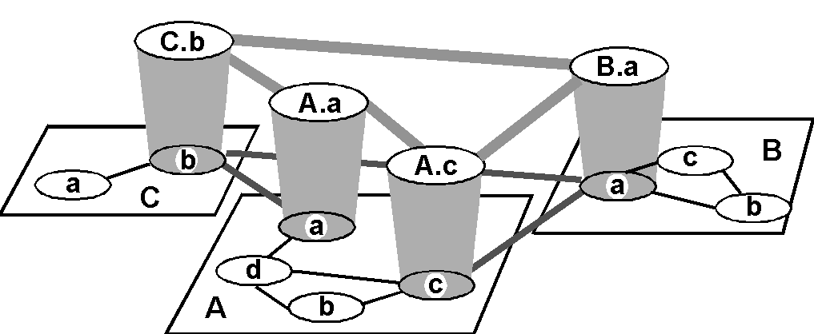
BGP Basics: Inter-AS routing

Slide 58
BGP Basics: Internet inter-AS routing
Path Vector protocol:
  similar to Distance Vector protocol
  each Border Gateway broadcast to neighbors (peers) entire path (I.e, sequence of ASs) to destination
  E.g., Gateway X may send its path to dest. Z:
Path (X,Z) = X,Y1,Y2,Y3,…,Z

Slide 59
BGP Basics: Internet inter-AS routing
Suppose: gateway X send its path to peer gateway W
W may or may not select path offered by X
  cost, policy (don’t route via competitors AS), loop prevention reasons.
If W selects path advertised by X, then:
Path (W,Z) = w, Path (X,Z)
Note: X can control incoming traffic by controlling it route advertisements to peers:
  e.g., don’t want to route traffic to Z -> don’t advertise any routes to Z

Slide 60
Sources of BGP Insecurity
IP Prefixes and Autonomous System Numbers
Using TCP as the Underlying Transport Protocol
Routing Policy and BGP Route Attributes

Slide 61
IP Address Ownership and Hijacking
IP address block assignment
  Regional Internet Registries (ARIN, RIPE, APNIC)
  Internet Service Providers
Proper origination of a prefix into BGP
  By the AS who owns the prefix
  … or, by its upstream provider(s) in its behalf
However, what’s to stop someone else?
  Prefix hijacking: another AS originates the prefix
  BGP does not verify that the AS is authorized
  Registries of prefix ownership are inaccurate

Slide 62
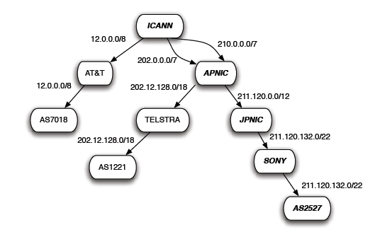
IP Address Delegation

Slide 63
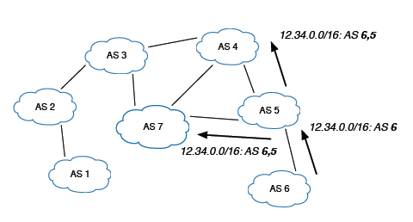
Normal Route Origination

Slide 64

Prefix Hijacking
4
3
5
2
7
6
1
12.34.0.0/16
12.34.0.0/16
Consequences for the affected ASes
  Blackhole: data traffic is discarded
  Snooping: data traffic is inspected, and then redirected
  Impersonation: data traffic is sent to bogus destinations

Slide 65
Sub-Prefix Hijacking
4
3
5
2
7
6
1
12.34.0.0/16
12.34.158.0/24
Originating a more-specific prefix
  Every AS picks the bogus route for that prefix
  Traffic follows the longest matching prefix

Slide 66
TCP Connection Underlying BGP Session
BGP session runs over TCP
  TCP connection between neighboring routers
  BGP messages sent over TCP connection
  Makes BGP vulnerable to attacks on TCP
Main kinds of attacks
  Against confidentiality: eavesdropping
  Against integrity: tampering
  Against performance: denial-of-service

Slide 67
TCP as the Transport Protocol
Attacks Against Confidentiality
  Third Party Can Eavesdrop BGP Session
  Learns Policy and Routing Information
  Business Relationships Can Be Inferred

Slide 68
TCP as the Transport Protocol
Attacks Against Message Integrity
  Man-In-The-Middle Attacks
  Message Insertion:
    Could Inject Incorrect Information
    Could Overwhelm Routers with Too Many Messages
  Message Deletion:
    Could Delete Keep-Alive Messages
  Message Modification
  Message Replay:
    Re-assert Withdrawn Route, Withdraw Valid Route

Slide 69
TCP as the Transport Protocol
Denial of Service Attacks
  Exploit the TCP Connection Establishment
    Three Way Handshake (SYN, SYN-ACK, ACK)
    Connection Closure (FIN, RST)
  Send RST Packet to Force Connection Closed
  SYN Packet Flooding
    Consumes Resources, Overwhelms Routers
    Neighbors Assume Connection Dead
      Upon Reconnection: Route Flapping
  Physical Attacks: Backhoe Attack
    Or Swamp Link with Traffic

Slide 70
Routing Policy and BGP Attributes
Local Preference, AS Path Length, Origin Type, Multi-exit Discriminator
Adversary Could Manipulate These Values
  Shorten AS Path Length
  Lengthen AS Path: Make Route Look Legit
    Or Use Too Many Resources to Store Path
  Remove AS from Path: Thwart Filtering
  Add AS to Path: Causes AS Path Loop
  Modify Origin Type, MED to Influence Decision

Slide 71
Summary: BGP is So Hard to Fix
Complex system
  Large, with around 30,000 ASes
  Decentralized control among competitive ASes
  Core infrastructure that forms the Internet
Hard to reach agreement on the right solution
  S-BGP with public key infrastructure, registries, crypto?
  Who should be in charge of running PKI and registries?
  Worry about data-plane attacks or just control plane?
Hard to deploy the solution once you pick it
  Hard enough to get ASes to apply route filters
  Now you want them to upgrade to a new protocol
  … all at the exact same moment?

